Slide 1

NYC Airbnb Data Analysis
Brenda Wardhaugh, Gurpreet Singh Dhameja, Lin Haoyue & Anna Puzinovici

Slide 2

Table of Contents
Neighbourhood Group
Room Types
Listing vs Neighbourhood
Room type vs Price ( Lin & Gurpreet) bar Graph + Boxplot
Avg Pricing listed by Area
Avg No. of Reviews by Area
Reviews Year wise
Top Neighbour
Longitude Latitude (scatter graph)

Slide 3
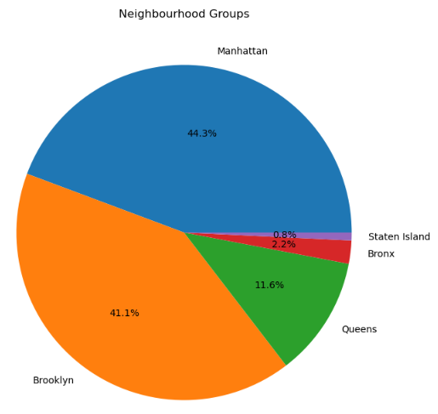
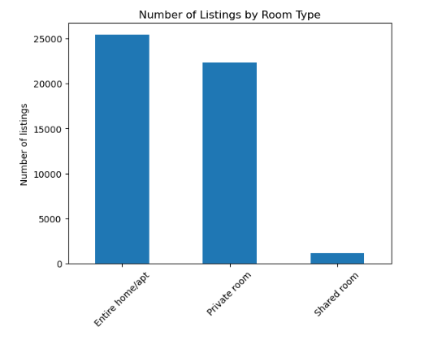
Which neighbourhoods have the most airbnb’s?
Which Room Type is the Most Popular?

Slide 4
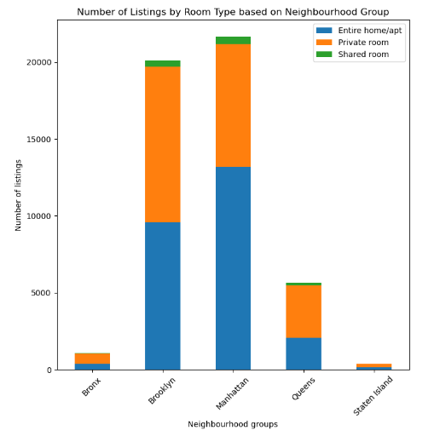
Within each Neighbourhood which Type of room is the most popular amongst airbnb hosts?

Slide 5
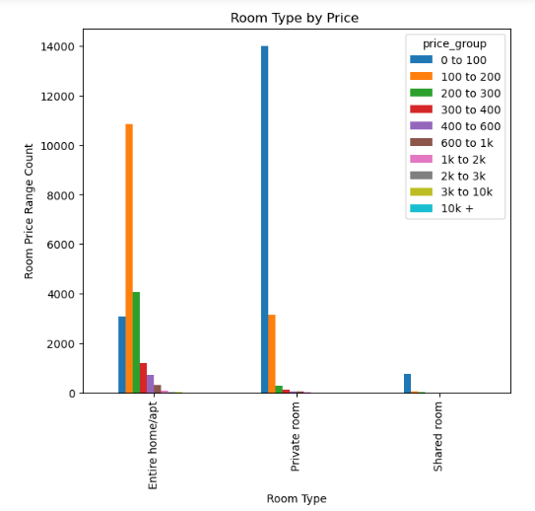
How does the Room Type Affect the Room Price?
We have 2 attributes that we look at: Room Price and the Room Type.
We break down the price into different price group, for example $0 to $100, $100 to $200, $200 to $300 and etc.
By looking at the plot we can see that, Shared Room and Private Room has the most of the price range from $0 to $100. While Entire Home/Apt has the price range from $100 to $200

Slide 6
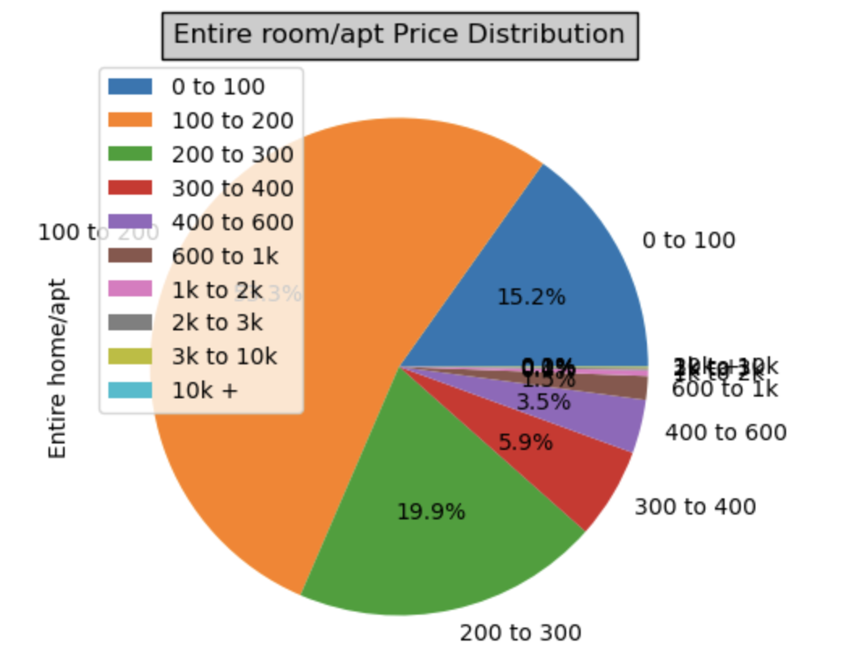
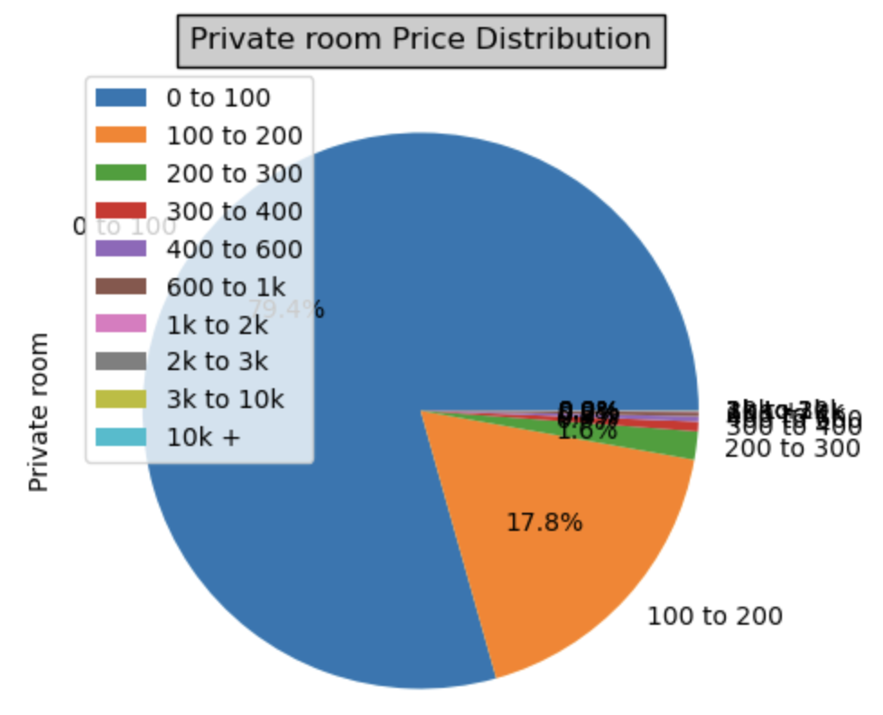
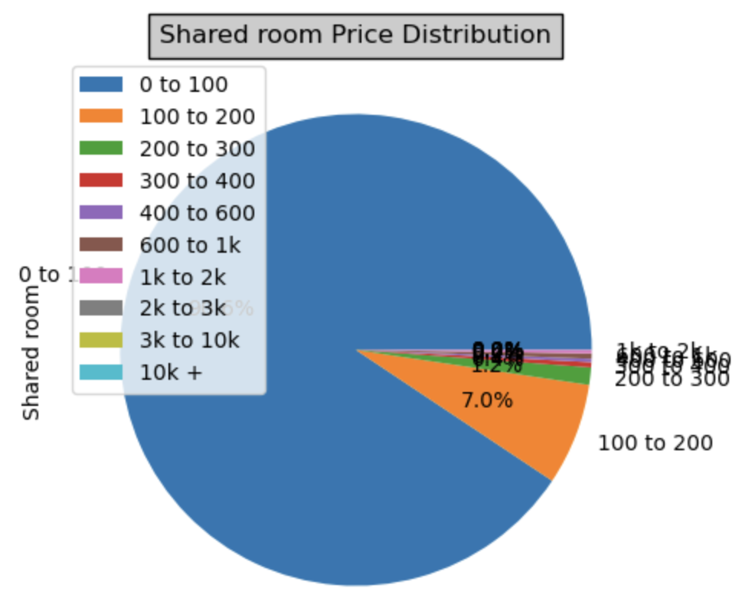
Pie Plot for each of the Room Type
We can see that 80% of the private room and 90% of the shared room also has the price range of $0 to $100, while 71% of the entire room/apt have the price range of $100 to $300.
We can see that shared room has the least price and entire room/apt has the more price.

Slide 7
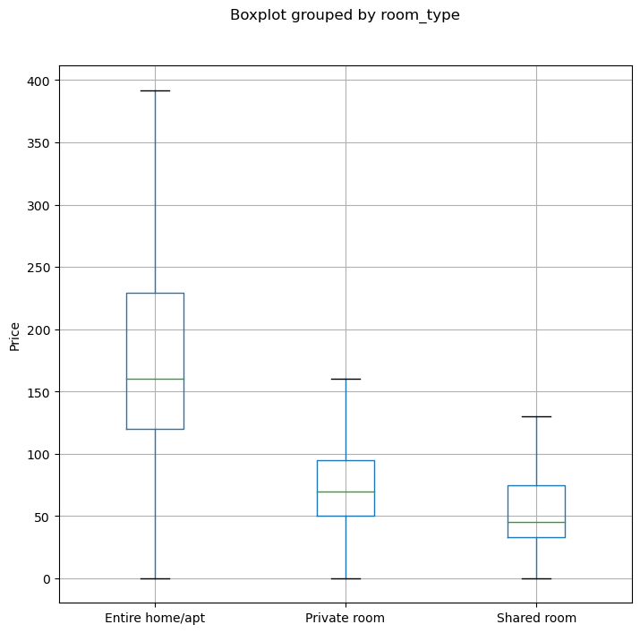

Mean price for private room and shared room can be seen below $100.
Whereas entire home/apt was bit expensive and cross $100 mean value

Slide 8
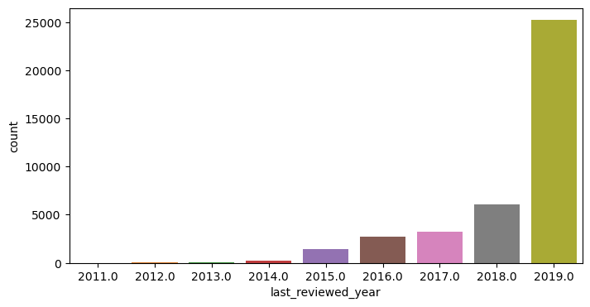

Number of Reviews Year Wise
Number of reviews were increased with the passage of time.
As graphs depicts, we can see immense growth from year 2014 till 2019.
Each year we can see growth of almost 1k from each year 2012 to 2018 and 2019 marked as the highest number of reviews received 25000.

Slide 9
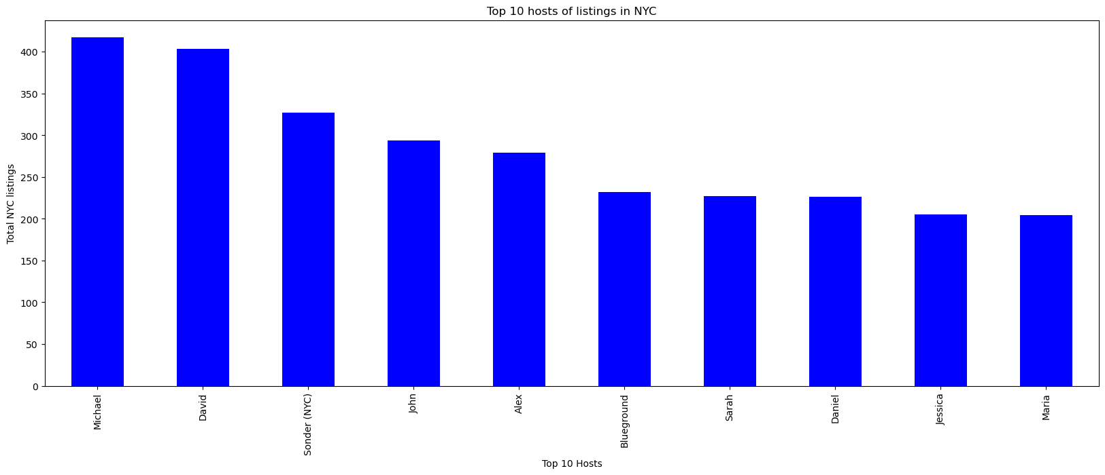
Top 10 Hosts in New York City
Top 10 hosts with total number of listings.
Where Michael tops the list with total 417 listings.
Jessica and Maria were halfway to Michael’s listings.

Slide 10
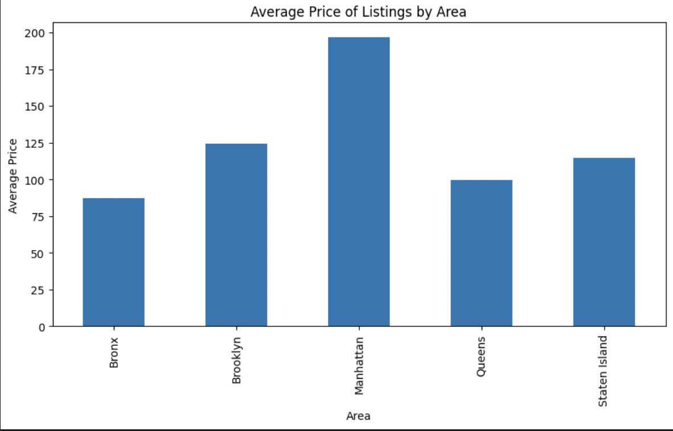
Is there any noticeable difference of traffic among different neighborhoods and why?
There is a noticeable difference in prices among different areas
The average price in Manhattan is significantly higher than other areas with a price of $196.87
This shows that this area is more upscale and expensive

Slide 11
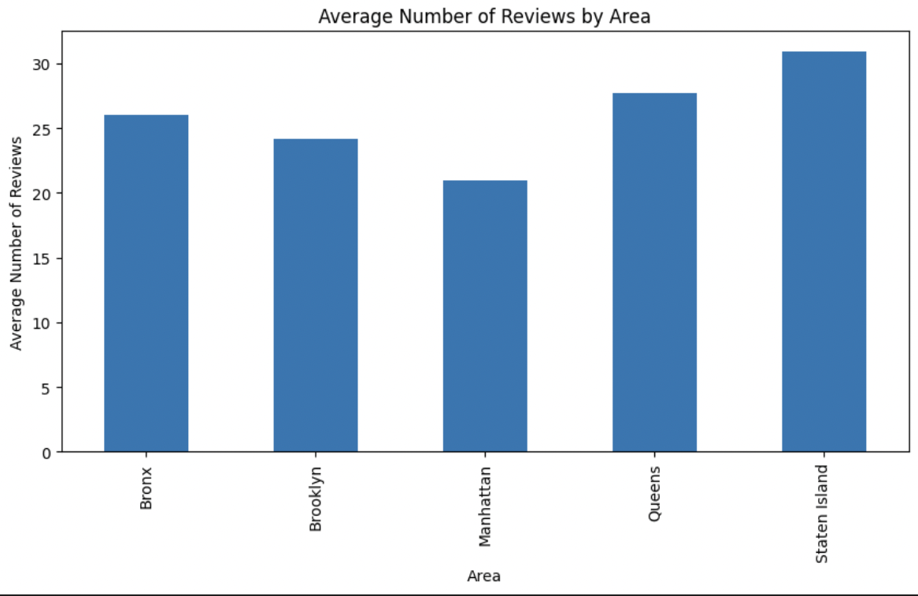
Number of Reviews per Area
Staten island has the highest number of reviews with an average of 30.9, this could be due to the area’s popularity among travellers, and the quality of listings
Interestingly, Manhattan doesn’t have that much reviews

Slide 12
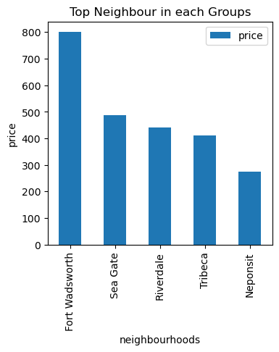
Top 10 neighbours In Each group
Fort Wadsworth, tops the table which is located in Staten Island with price of $800. This could be due to the availability throughout the year.
Neponsit was most popular in Queens with the pricing of $275
There were minor price difference between Sea Gate, Riverdale and Tribeca as they are part of Brooklyn, Bronx and Manhattan respectively.

Slide 13
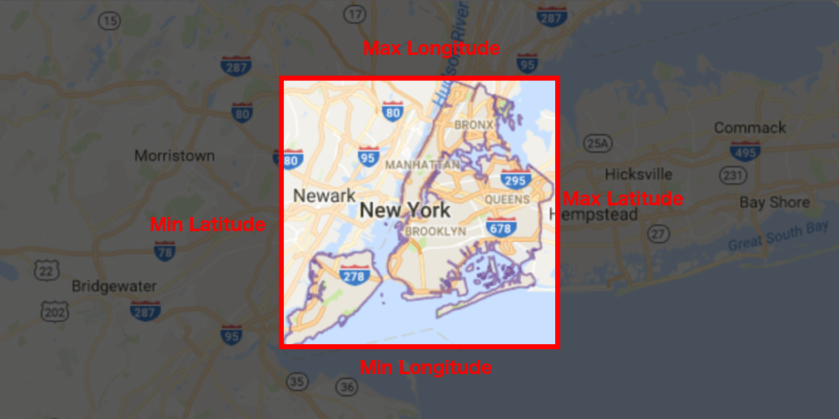
New York City Longitude and Latitude

Slide 14
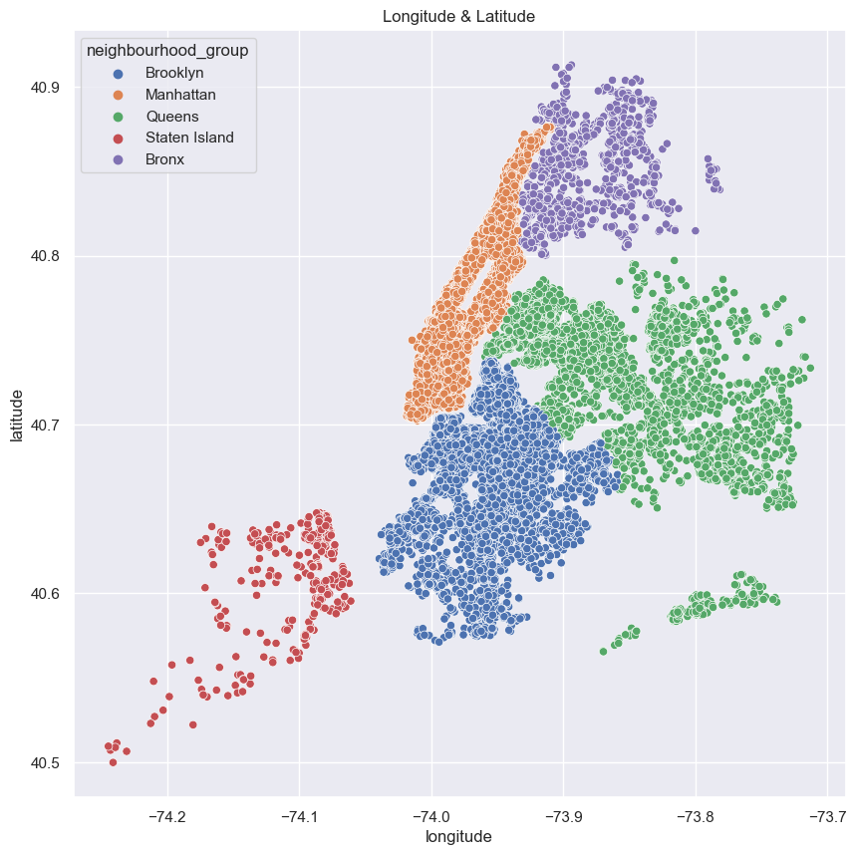
Graphical Representation of New York

Slide 15


